Slide 1
3D & Texture Mapping
Session 05

Slide 2
OUTLINE
Box Modeling
NURBS
3D Sculpting
Common Approaches
Modeling Methodology
Critical Analysis

Slide 3
Box Modeling
Box modeling is just as the name implies.
start with a polygon box, and cut, extrude, and refine until you have a finished model.
freeform approach to modeling, and it somewhat mimics the process of sculpting with clay.

Slide 4
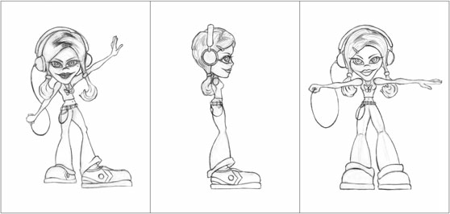
1. Concept Sketch
A posed concept sketch of a character, along with two turnaround sketches

Slide 5
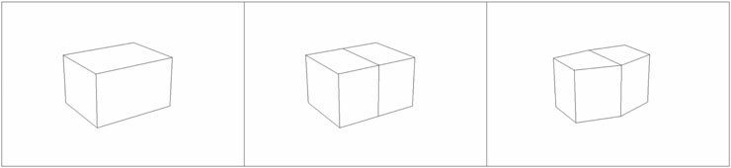
2. Roughing Out the Character
Start with a box, cut a centerline, and then approximate the torso shape.

Slide 6
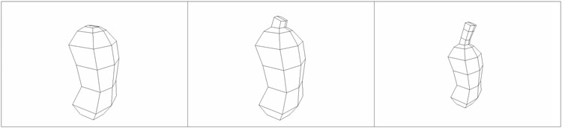
Extrude and form the torso, and then extrude and adjust the neck

Slide 7
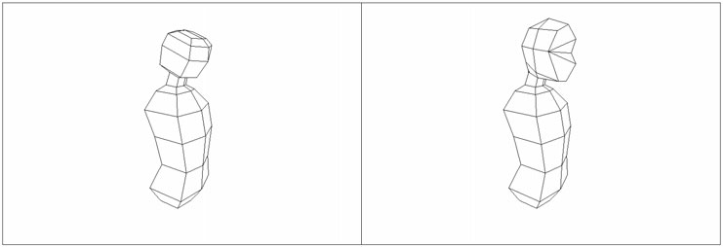
Neck extruded and cut to approximate a head.

Slide 8
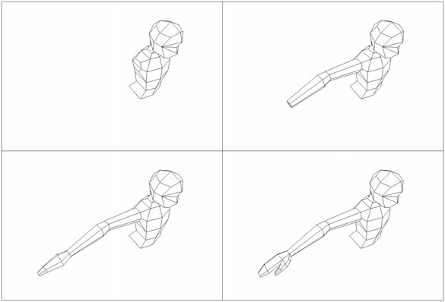
Right arm constructed through extruding and adjusting

Slide 9
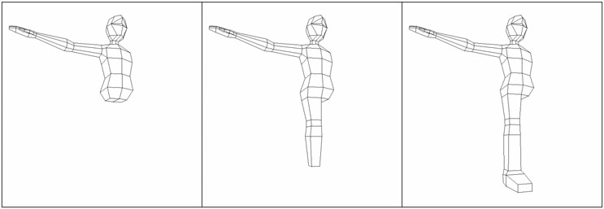
Right leg constructed through extruding and adjusting

Slide 10
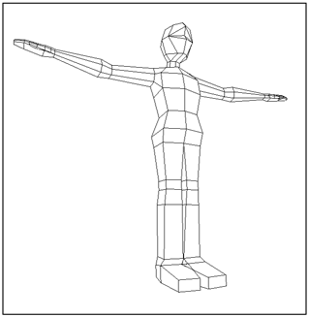
Mirror half of the body to create the left arm and left leg.

Slide 11
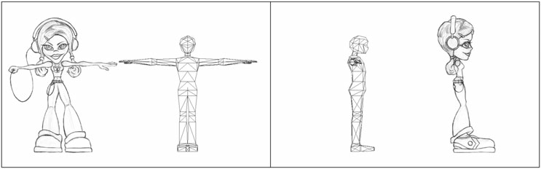
3. Refining the Model
Compare the rough model to the turnaround sketches

Slide 12
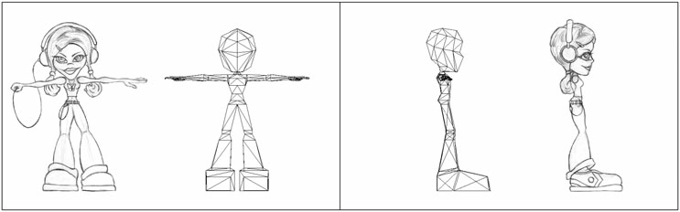
Proportions matched.

Slide 13
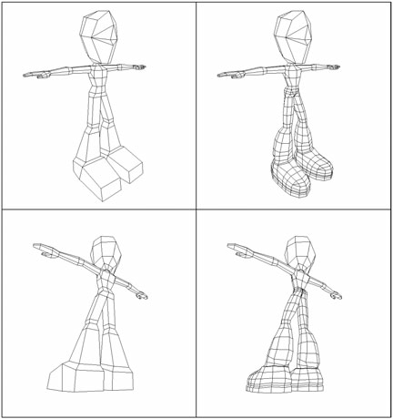
Adding detail in the leg

Slide 14
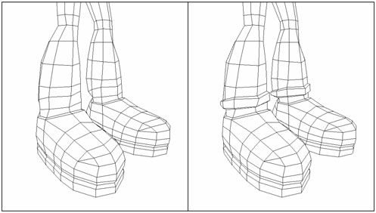
Extrude the cuffs out.

Slide 15
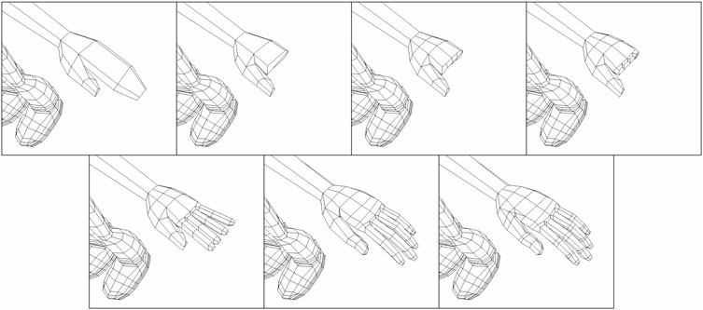
Sequence showing the buildup of a hand

Slide 16
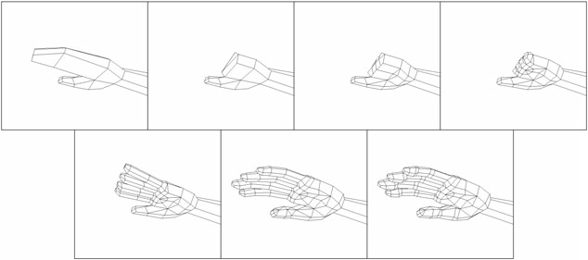
Sequence showing the buildup of a hand, shown from the underside

Slide 17
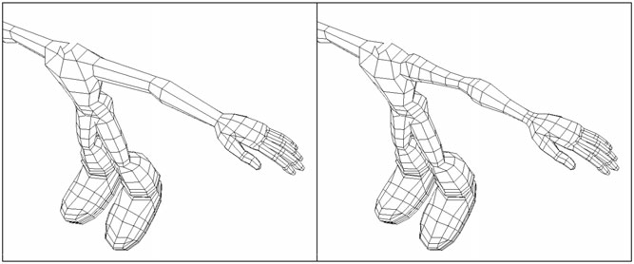
Sequence showing the buildup of an arm.

Slide 18
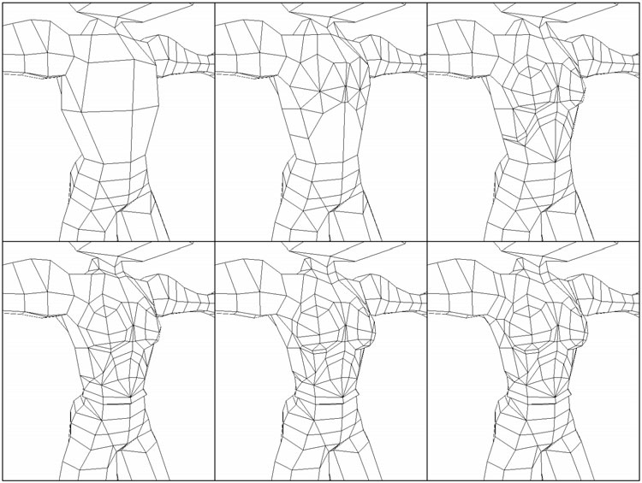
Sequence showing the buildup of the torso detail, from the front

Slide 19
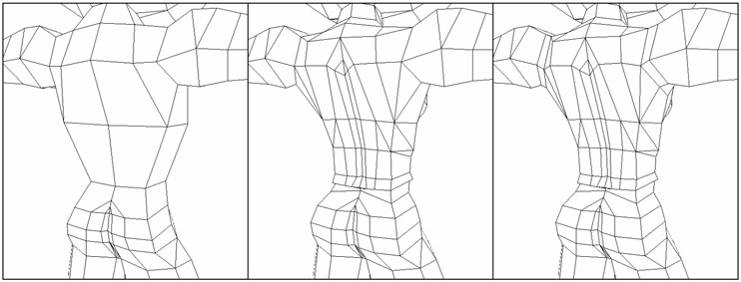
Sequence showing the buildup of the torso detail, from the back

Slide 20
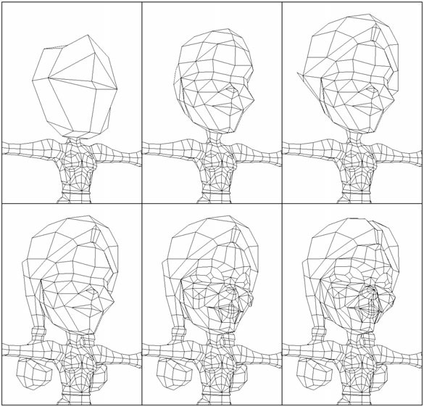
Sequence showing the buildup of the head detail

Slide 21
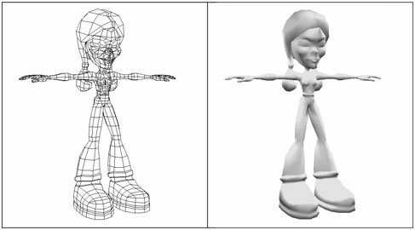
The completed character in wireframe and shaded

Slide 22
NURBS
NURBS is an acronym for “Non Uniform Rational Basis Spline
it is a form of modeling that uses curved surfaces based on relatively few data points
used extensively in the film industry for quite a while, and have limited use in the gaming industry.
A NURBS spline is made up of control vertices (CV)

Slide 23
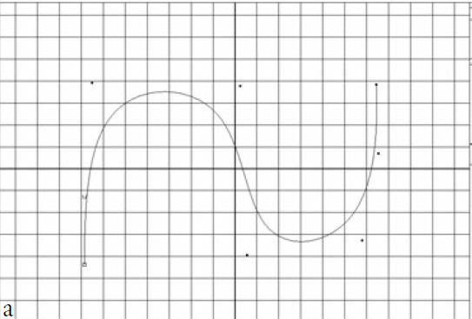
A NURBS spline defined by control vertices

Slide 24
NURBS
NURBS surface is a curved 3D mesh that is defined by multiple NURBS splines and is often referred to as a patch
NURBS surfaces generally have four sides
Arm can be modeled by wrapping the NURBS surface into a basic cylindrical shape and then refined to add support for joints, muscle bulges, and other definition
face is divided into sections with a patch circling the mouth, a patch circling the eyes, and additional patches to support the remaining facial structures and to bridge the other patches.

Slide 25
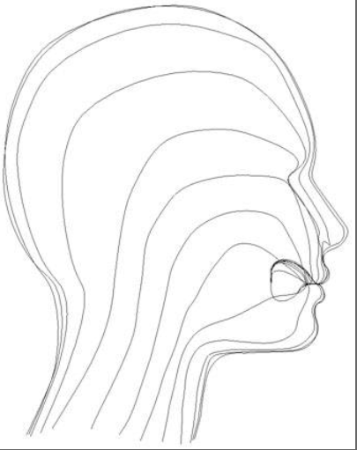
The curves that define the facial features generally follow the direction of the muscles.

Slide 26
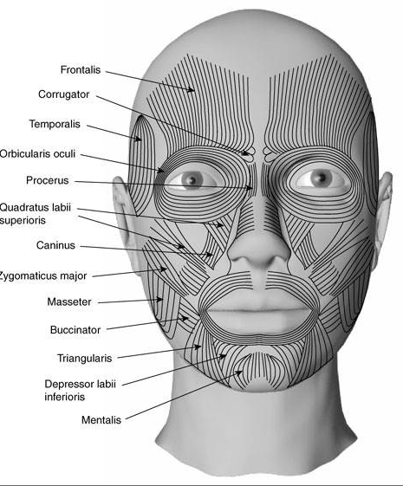
The muscles of the head are divided into three groups. These are the scalp, face and mastication

Slide 27
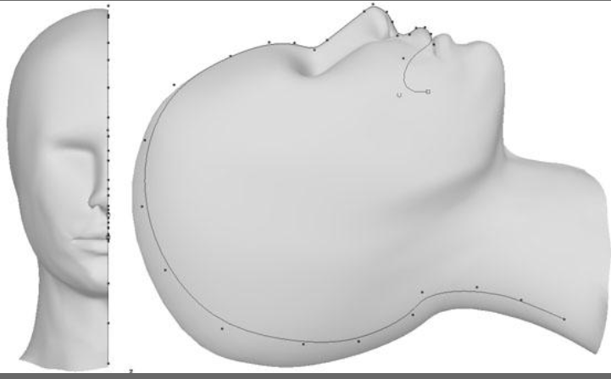
The first curve defines the profile and middle of the head. It starts on the inside of the mouth and ends at the base of the neck.

Slide 28
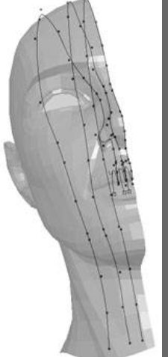
The first three curves against a template. The second and third ones begin to define the side of the nose and gradually turn away from the first one. Their farthest points from the first curve is at the back of the head.

Slide 29
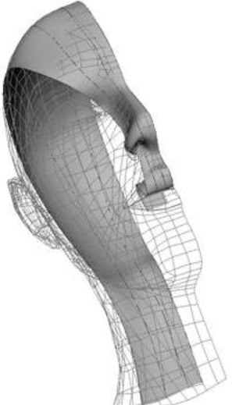
Editing the curves on the partial loft against a templated three dimensional head.

Slide 30
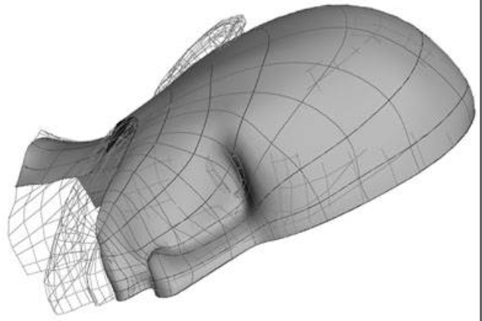
Edit the points so that the curves in both the U and V directions flow smoothly.

Slide 31
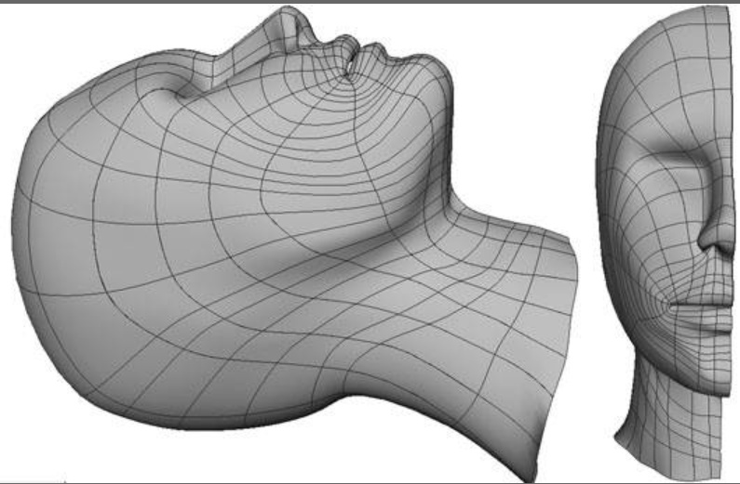
The finished half face. Note the directions of the U and Vcurves. The placement of points on each curve will determine the success of your connecting lines.

Slide 32
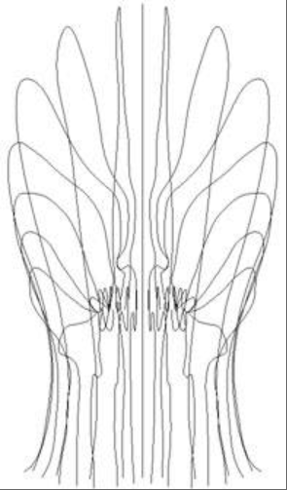
More info: http://www.creativecrash.com/tutorials/modeling-a-nurbs-head-general-concept-tutorial-/page3
Curves are duplicated and mirrored for the other half.

Slide 33
NURBS
Advantages
Resolution independent
Can tessellate “on the fly”
Curved surfaces
Inherent mapping coordinates

Slide 34
NURBS
Disadvantages
Build using only square patches, which is not ideal for complex objects such as hands
Tangency between patches can be difficult to solve
Topology problems (lining up isoparms)
Difficult to change between high- and low-density areas
Can result in an unwieldy number of isoparms
Not supported by all game engines

Slide 35
3D Sculpting
Programs like ZBrush from Pixologic allow you to push, pull, and sculpt high-resolution models without worrying about topology
Alternative for Open-Source Application is Blender, using its sculpting feature.
Three-dimensional sculpting is by far the best technique for creating high-quality normal maps.
A normal map is a texture that is applied to a low-resolution model that gives the illusion that there is much more detail than actually exists

Slide 36
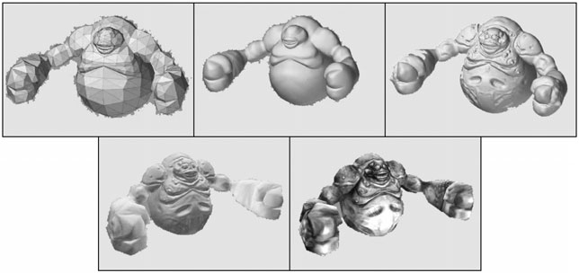
a
b
c
d
e
Original low-poly mesh
Tesselated high-resolution mesh
Sculpted detail
Low-resolution mesh with normal map applied
Final rendering, low-resolution model with normal map and texture

Slide 37
Common Approaches to Constructing Geometry
Case Study: Final Drive Nitro
modeling cars and levels for a racing game
Racing games are a great example of a non-character-based genre where the structure of the game puts many requirements on the modeling.

Slide 38
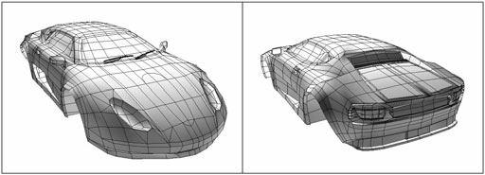
Wireframe of a car model.

Slide 39
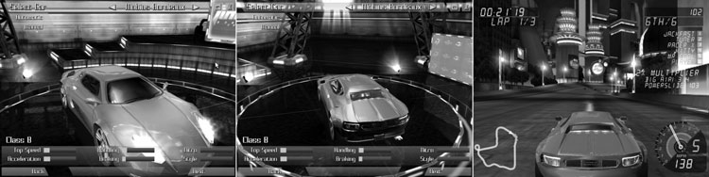
The same car, seen in the car select screen and during gameplay

Slide 40
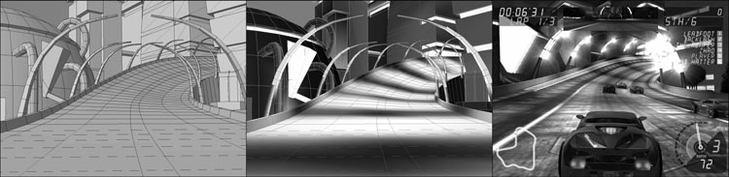
Wireframe model of a level
Model with vertex lighting
Textures and effects added

Slide 41
Common Approaches to Constructing Geometry
Low-Polygon Modeling
polygon counts increase exponentially with each generation of hardware, and normal mapping makes high-polygon modeling a valuable skill to master, low-polygon modeling isn’t going away anytime soon.

Slide 42
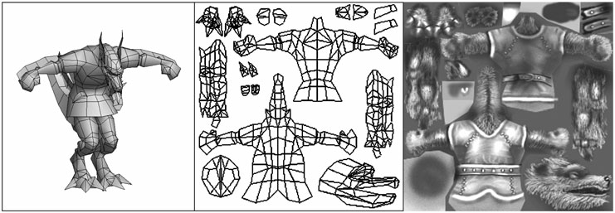
Wireframe low-polygon monster
Mapping coordinates for the monster.
Texture map

Slide 43
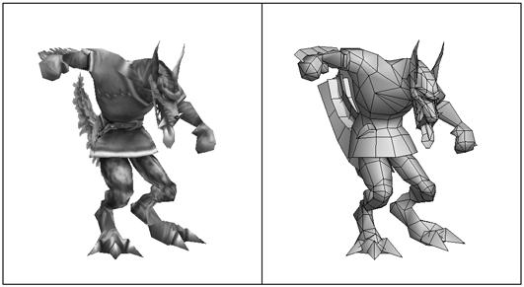
Finished and posed model

Slide 44
Modeling Methodology
Use Reference Material
Work Rough and Refine

Slide 45
Critical Analysis
Profiles
Rotate the model to all angles and compare them to an actual person
Topology
how the vertices, faces, and edges are laid out and arranged to form the various structures of a model.
Objective Opinion
Get someone else to look at your model and offer his or her initial reaction to your work
Expressiveness and Essence
Does your model capture the character, personality, and emotion of the reference sketches?

Slide 46
Q & A

